Slide 1
BRITISH AIRWAYS
Predictive analysis of customer buying behaviour
Data exploration, predictive modelling and evaluation

Slide 2
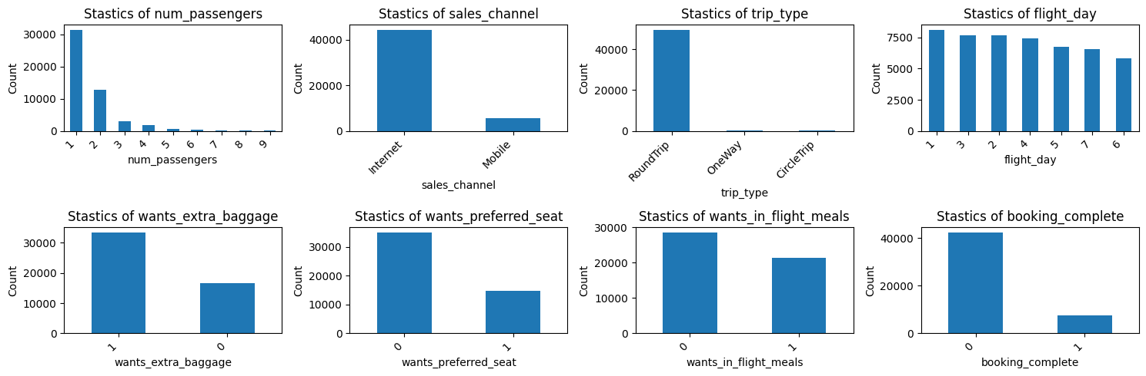
Data exploration: Statistics of feature data points

Slide 3
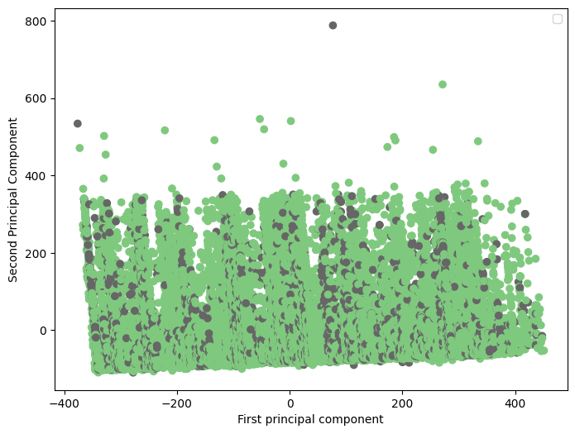
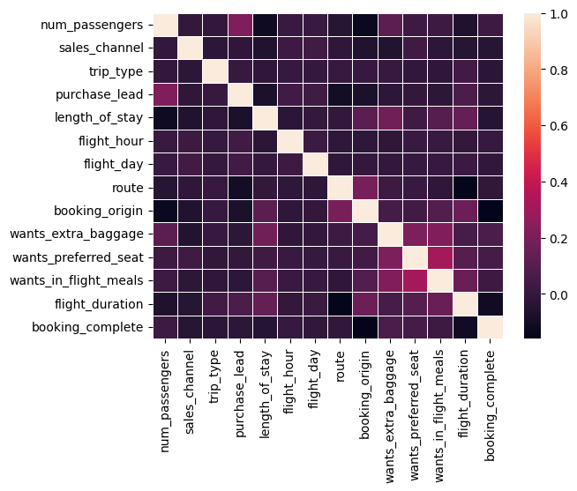
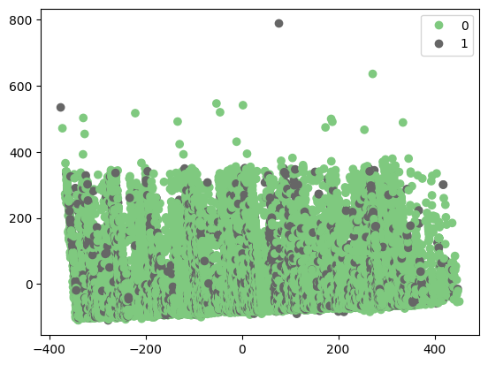
Data exploration: correlation analysis and dimensionality reduction of features
Pearson’s correlation heatmap
PCA-reduced features scatter plot

Slide 4
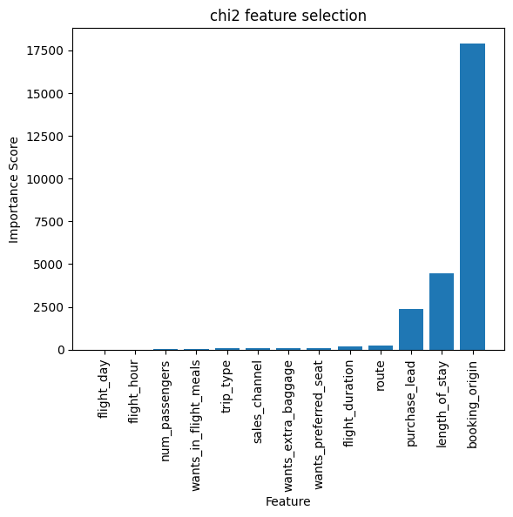
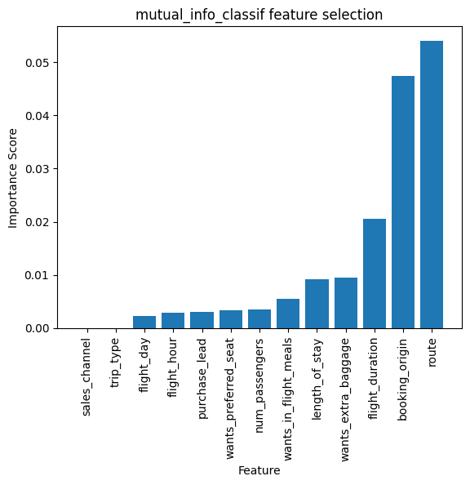
Feature selection
Chi-Squared Feature Selection
Mutual Information Feature Selection

Slide 5
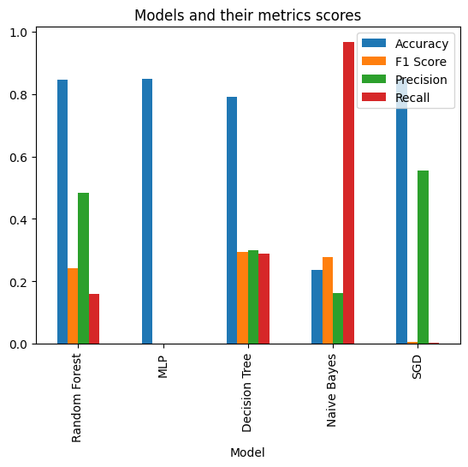
Model fitting evaluation metrics
Fitted classification models:
Random Forest Classifier
Neural Network (MLP) Classifier
Decision Tree Classifier
Naïve Bayes Classifier
Stochastic Gradient Descent Classifier
Evaluation metrics:
Accuracy
F1 Score
Precision
Recall

